Slide 1


L5 - Major Religions Of India
Chandra T.M.

Slide 2
Hinduism
Hinduism is the world's third most popular religion, with around 750 million followers. Places : Mandir

Slide 3
More Info on Hinduism
The religion of Hinduism originated in Northern India, near the river Indus, about 4000 years ago and is the world's oldest existing religion. Hinduism is practised by more than 80% of India's population.
Sacred text : Bhagavat Gita

Slide 4
More about Hinduism
Place of Origin : India
Founder : Developed out of Brahminism
Aum is the main symbol of Hinduism. It is the sound heard in deepest meditation and is said to be the name most suited for God.
or many Hindus, religion is a matter of practice rather than of beliefs. It's more what you do, than what you believe. Hindus believe in a universal soul or God called Brahman. Brahman takes on many forms that some Hindus worship as gods or goddesses in their own right. Hindus believe that there is a part of Brahman in everyone and this is called the Atman.

Slide 5
More Info on Hinduism
Hindus believe in reincarnation - a belief that the soul is eternal and lives many lifetimes, in one body after another. The soul is sometimes born in a human body, sometimes in an animal body and sometimes in a plant body etc.. Hindus believe that all forms of life contain a soul, and all souls have the chance to experience life in different forms.
Samsara means going through the cycle of repeated births and deaths (reincarnation). Hindus believe that existence of this cycle is governed by Karma

Slide 6
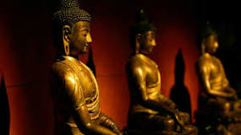
Buddhism

Slide 7
Info on Buddhism
Its practice has historically been most prominent in East and Southeast Asia, but its influence is growing in the West. Many Buddhist ideas and philosophies overlap with those of other faiths.
Followers of Buddhism don’t acknowledge a supreme god or deity. They instead focus on achieving enlightenment—a state of inner peace and wisdom. When followers reach this spiritual echelon, they’re said to have experienced nirvana.

Slide 8
More Info On Buddhism
Buddhism is a faith that was founded by Siddhartha Gautama (“the Buddha”) more than 2,500 years ago in India. With about 470 million followers, scholars consider Buddhism one of the major world religions.

Slide 9
More Info on Buddhism
The religion’s founder, Buddha, is considered an extraordinary man, but not a god. The word Buddha means “enlightened.”
The path to enlightenment is attained by utilizing morality, meditation and wisdom. Buddhists often meditate because they believe it helps awaken truth.
There are many philosophies and interpretations within Buddhism, making it a tolerant and evolving religion.

Slide 10
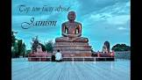
Jainism

Slide 11
Info
Jainism is an ancient religion from India that teaches that the way to liberation and bliss is to live lives of harmlessness and renunciation. The essence of Jainism is concern for the welfare of every being in the universe and for the health of the universe itself

Slide 12
More Info on Jainism
Liberation is achieved by eliminating all karma from the soul.
Jainism is a religion of self-help.
There are no gods or spiritual beings that will help human beings.
The three guiding principles of Jainism, the 'three jewels', are right belief, right knowledge and right conduct.
The supreme principle of Jain living is non violence (ahimsa)

Slide 13
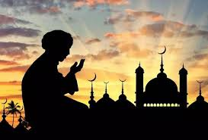
Islam

Slide 14
Info On Islam
The word “Islam” means “submission to the will of God.”
Followers of Islam are called Muslims.
Muslims are monotheistic and worship one, all-knowing God, who in Arabic is known as Allah.
Followers of Islam aim to live a life of complete submission to Allah. They believe that nothing can happen without Allah’s permission, but humans have free will.

Slide 15
More Info on Islam
Islam teaches that Allah’s word was revealed to the prophet Muhammad through the angel Gabriel.
Muslims believe several prophets were sent to teach Allah’s law. They respect some of the same prophets as Jews and Christians, including Abraham, Moses, Noah and Jesus. Muslims contend that Muhammad was the final prophet.

Slide 16

Zoroastrinism

Slide 17
Info on Zoroastrinism
Zoroastrianism or Mazdayasna is one of the world's oldest continuously practiced religions.
The Avesta is a collection of the central religious texts of Zoroastrianism written in the old Iranian dialect of Avestan.
The history of the Avesta is speculated upon in many Pahlavi texts with varying degrees of authority, with the current version of the Avesta dating at oldest from the times of the Sasanian Empire

Slide 18
More Info on Zoroastrinism
Zoroastrianism was founded by Zoroaster (or Zarathushtra) in ancient Iran. The precise date of the founding of Zoroastrianism is uncertain and dates differ wildly from 2000 BCE to "200 years before Alexander". Zoroaster was born in either Northeast Iran or Southwest Afghanistan.
According to later Zoroastrian tradition, when Zoroaster was 30 years old, he went into the Daiti river to draw water for a Haoma ceremony; when he emerged, he received a vision of Vohu Manah

Slide 19
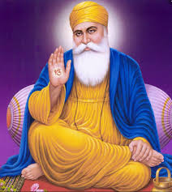
Sikhism

Slide 20
Info on Sikhism
Sikhism, religion and philosophy founded in the Punjab region of the Indian subcontinent in the late 15th century. ... The Sikhs call their faith Gurmat (Punjabi: “the Way of the Guru”). According to Sikh tradition, Sikhism was established by Guru Nanak (1469–1539) and subsequently led by a succession of nine other Gurus.

Slide 21
More Info on Sikhism
All 10 human Gurus, Sikhs believe, were inhabited by a single spirit. Upon the death of the 10th, Guru Gobind Singh (1666–1708), the spirit of the eternal Guru transferred itself to the sacred scripture of Sikhism.
Guru Granth Sahib (“The Granth as the Guru”), also known as the Adi Granth (“First Volume”), which thereafter was regarded as the sole Guru.
In the early 21st century there were nearly 25 million Sikhs worldwide, the great majority of them living in the Indian state of Punjab.

Slide 22
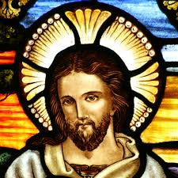
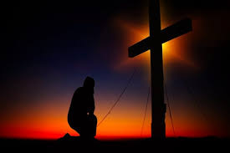
Christianity

Slide 23
Info on Christianity
Christianity is the most widely practiced religion in the world, with more than 2 billion followers. The Christian faith centers on beliefs regarding the birth, life, death and resurrection of Jesus Christ.
Belief in God the Father, Jesus Christ as the Son of God, and the Holy Spirit. The death, descent into hell, resurrection and ascension of Christ..

Slide 24
More Info on Christianinty
Place of Origin | Israel
Founder | Jesus of Nazareth
Sacred Text | The Bible - Old and New Testaments
Sacred Building | Church, Chapel, Cathedral
Holy Places | Jerusalem, Bethlehem, Nazareth, Lourdes (a popular place of pilgrimage), Rome, Canterbury
Major Festivals | Easter, Christmas,
Main Branches (Denominations) | Anglican, Roman Catholic, Free Churches, Orthodox, Reformed,

Slide 25
More Info on Christianity
The holiness of the Church and the communion of saints. Christ's second coming, the Day of Judgement and salvation of the faithful.

